Slide 1


Configure VNet Peering

Slide 2



Determine VNet Peering Uses
Region 1
Region 2
VNet1
Global
VNet Peering
VNet2
Regional
VNet Peering
VNet3
Two types of peering: Global and Regional
Connects two Azure virtual networks – you can peer across subscriptions and tenants
Peered networks use the Azure backbone for privacy and isolation
Easy to setup, seamless data transfer, and great performance

Slide 3
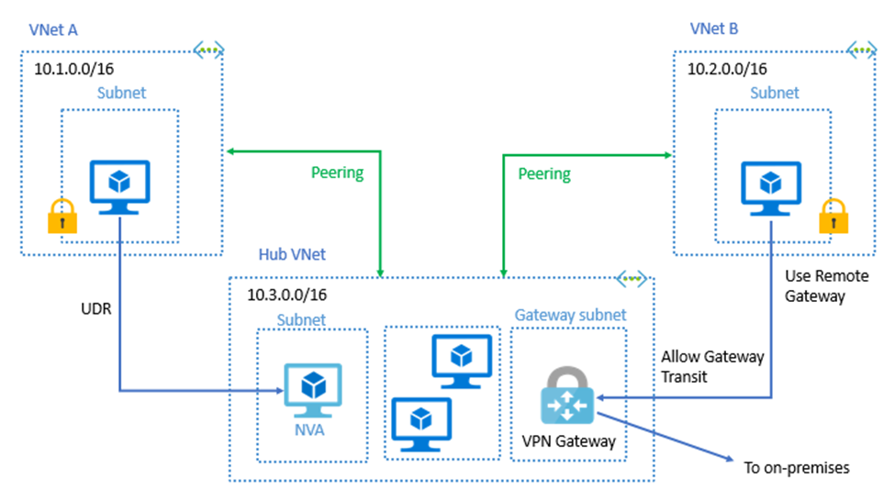
Determine Gateway Transit and Connectivity Needs
Gateway transit allows peered virtual networks to share the gateway and get access to resources
No VPN gateway is required in
the peered spoke virtual network
Default VNet peering provides
full connectivity
IP address spaces of connected networks can't overlap

Slide 4
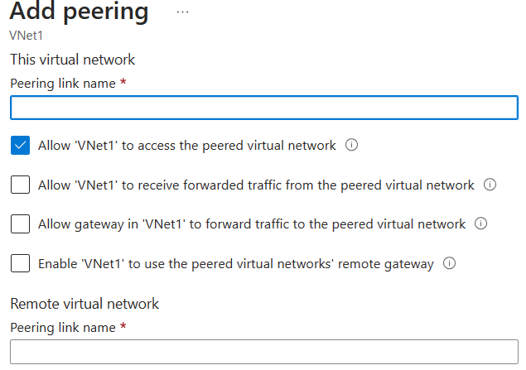
Create VNet Peering
Allow virtual network access settings
Configure forwarded traffic settings
Status should show “connected”
Notes:
Create, change, or delete a virtual network peering - https://docs.microsoft.com/azure/virtual-network/virtual-network-manage-peering#requirements-and-constraints
Tutorial: Connect virtual networks with virtual network peering using the Azure portal - https://docs.microsoft.com/azure/virtual-network/tutorial-connect-virtual-networks-portal
✔️ When you add a peering on one virtual network, the second virtual network configuration is automatically added.

Slide 5
Determine Service Chaining Uses
Leverage user-defined routes and service chaining to implement custom routing
Implement a VNet hub with a network virtual appliance or a VPN gateway
VNet2
Hub VNet
Network Virtual Appliance or
VPN Gateway
Service chaining enables you to direct traffic from one virtual network to a virtual appliance, or virtual network gateway,
in a peered virtual network, through
user-defined routes
VNet3
Notes:
Distribute your services across Azure virtual networks and integrate them by using virtual network peering - https://docs.microsoft.com/learn/modules/integrate-vnets-with-vnet-peering

Slide 6
Virtual Network Peering: Demonstration
Configure VNet peering on the first virtual network
Confirm VNet peering on the second virtual network
Notes:
Demonstration Virtual Network Peering- https://microsoftlearning.github.io/AZ-104-MicrosoftAzureAdministrator/Instructions/Demos/05%20-%20Administer%20Intersite%20Connectivity.html#configure-vnet-peering

Slide 7
Configure Network Routing and Endpoints

Slide 8


Review System Routes
Directs network traffic between virtual machines, on-premises networks, and the internet
Traffic between VMs in the same subnet
Between VMs in different subnets in the same virtual network
Data flow from VMs to the internet
Communication between VMs using a VNet-to-VNet VPN
Site-to-Site and ExpressRoute communication through the
VPN gateway
Internet
System
Route
System
Route
Frontend Subnet
Backend Subnet
Routing Table
Virtual Network

Slide 9
Identify User-Defined Routes
A route table contains a set of rules, called routes, that specifies how packets should be routed in a virtual network
Internet
User defined route
VM/Appliance
IP Forwarding
User-defined routes are custom
routes that control network traffic by defining routes that specify the next hop of the traffic flow
System
Route
Frontend Subnet
Backend Subnet
The next hop can be a virtual network gateway, virtual network, internet, or virtual appliance
User defined route
VM/Appliance
IP Forwarding
Virtual Network
Notes:
Virtual network traffic routing - https://docs.microsoft.com/azure/virtual-network/virtual-networks-udr-overview
✔ Each route table can be associated to multiple subnets, but a subnet can only be associated to a single route table. There are no additional charges for creating route tables in Microsoft Azure. Do you think you will need to create custom routes?

Slide 10
Custom Routing Tables: Demonstration
Create a route table
Add a route
Associate a route table to a subnet

Slide 11
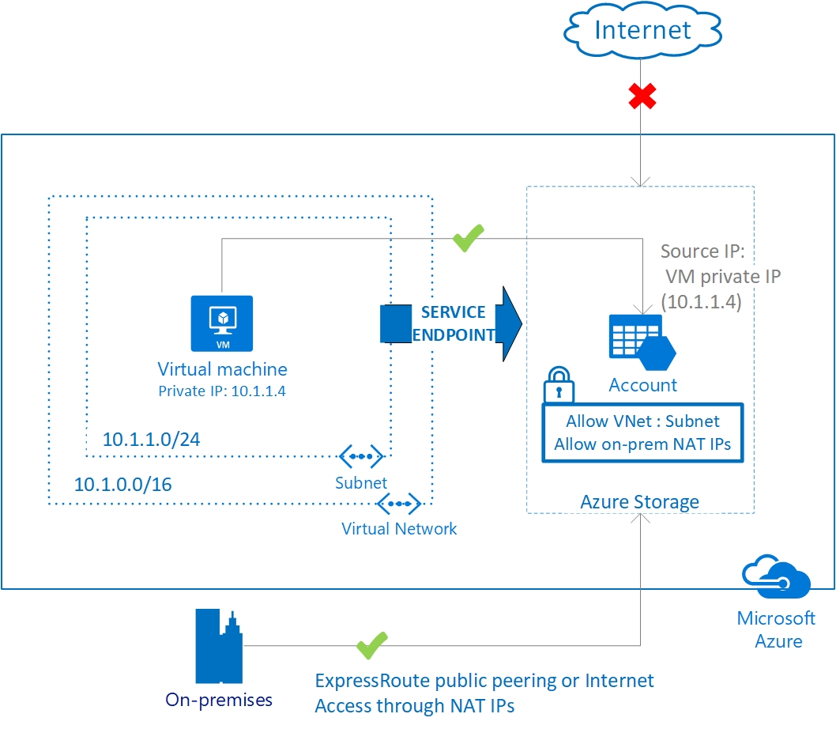
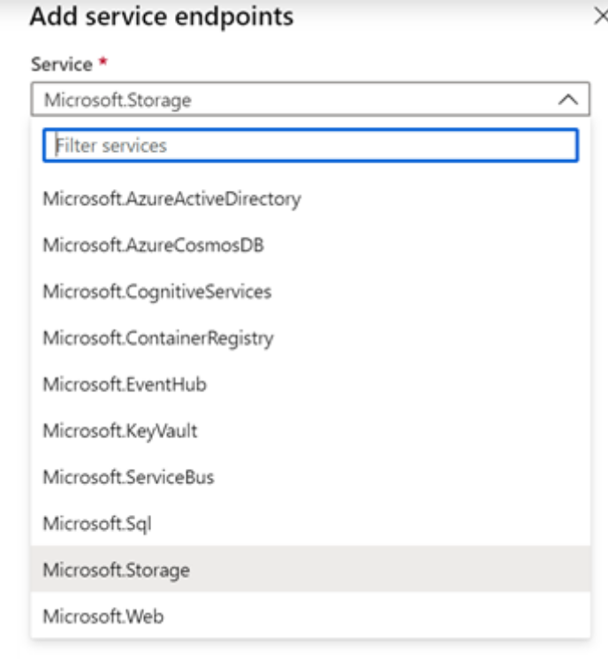
Determine Service Endpoint Uses
Endpoints limit network access to specific services
Adding service endpoints can take up to 15 minutes to complete
Notes:
This is 2 topics in the student content.
Virtual network service endpoints - https://docs.microsoft.com/azure/virtual-network/virtual-network-service-endpoints-overview
Tutorial: Restrict network access to PaaS resources with virtual network service endpoints using the Azure portal - https://docs.microsoft.com/azure/virtual-network/tutorial-restrict-network-access-to-resources
Improved security for your resources
Optimal routing for your services
Uses the Azure backbone and is simple to configure
✔️ Can you see a use for service endpoints in your organization?

Slide 12
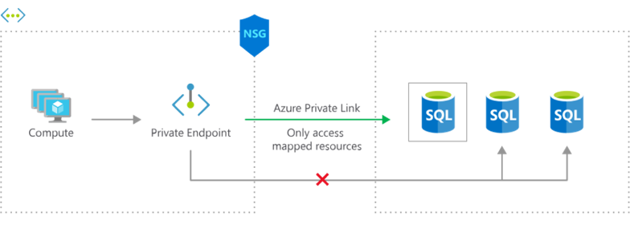
Identify Private Link Uses
Private connectivity to services on Azure. Traffic remains on the Microsoft network, with
no public internet access
Integration with on-premises and peered networks
In the event of a security incident within your network, only the mapped resource would be accessible

Slide 13
Lab - Implement Intersite Connectivity

Slide 14



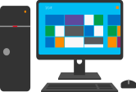











Module Review Activity
??
On-premises machine
??
Name?
Name?
??
Name?
Name?
??
On-premises network
Application
gateway
Azure
firewall
Load
balancer
NAT
Private
endpoint
Service
endpoint
VNet Peering
VPN
Gateway
Notes:
Use the diagram to engage students and reinforce topics that have just been covered. If you remove the green square (??) the product icon will show. Discuss the options with the students.
Site to site = On-premises networks to Azure virtual networks
Point to Site = On-premises machines to Azure virtual networks
Gateway subnet name = GatewaySubnet
Azure firewall subnet name = AzureFirewallSubnet

Slide 15
Lab 05 – Implement intersite connectivity
Job Skills
Task 1: Create a virtual machine and virtual network.
Task 2: Create a virtual machine in a different virtual network.
Task 3: Use Network Watcher to test the connection between virtual machines.
Task 4: Configure virtual network peering between virtual networks.
Task 5: Use Azure PowerShell to test the connection between virtual machines. RDP optional.
Task 6: Create a custom route.
In this lab, you will explore communication between virtual networks.
You will implement virtual network peering and test connections.
You will also learn about the Network Watcher tool.

Slide 16





Lab 05 – Architecture diagram
az104-rg5
  East US
  East US
Task 3
CoreServicesVnet
(10.0.0.0/16)
ManufacturingVnet
(172.16.0.0/16)
Task 6
Task 1
Core
(10.0.0.0/24)
Task 2
Manufacturing
(172.16.0.0/24)
Perimeter
(10.0.1.0/24)
CoreServicesVM
Task 4
ManufacturingVM
Task 5

Slide 17
Lab 05 – Architecture diagram (interactive lab simulation)
Region1
Task 1
az104-05-rg1
az104-05-vnet0 10.50.0.0/22
Region2
Subnet0 10.50.0.0/24
Task 2, Task 3
az104-05-rg1
az104-05-vm0
10.50.0.4
Global Peering
az104-05-vnet2 10.52.0.0/22
Subnet0 10.52.0.0/24
az104-05-rg1
Local Peering
Global Peering
az104-05-vm2
10.52.0.4
Subnet0 10.51.0.0/24
az104-05-vm1
10.51.0.4
az104-05-vnet1 10.51.0.0/22
Notes:
This architecture diagram is for the interactive lab simulation, if you want to review that.

Slide 18
Thank You!

